Slide 1
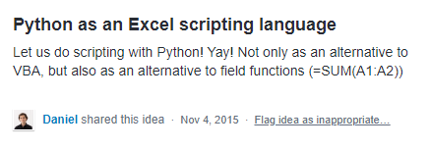
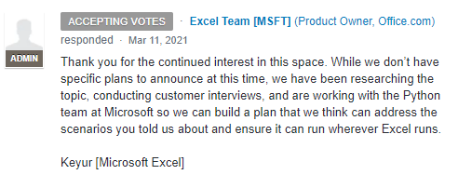
how it started how it’s going

Slide 2





Reject modernity
Embrace tradition

Slide 3
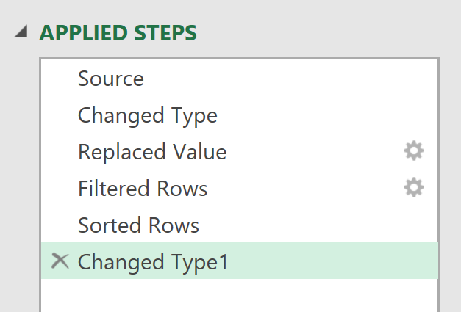
EVERY STEP YOU TAKE
I’LL BE WATCHING YOU

Slide 4
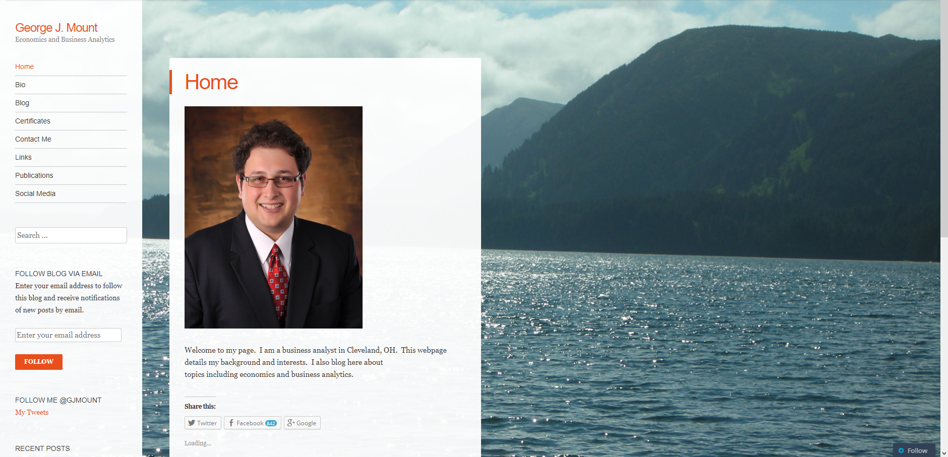
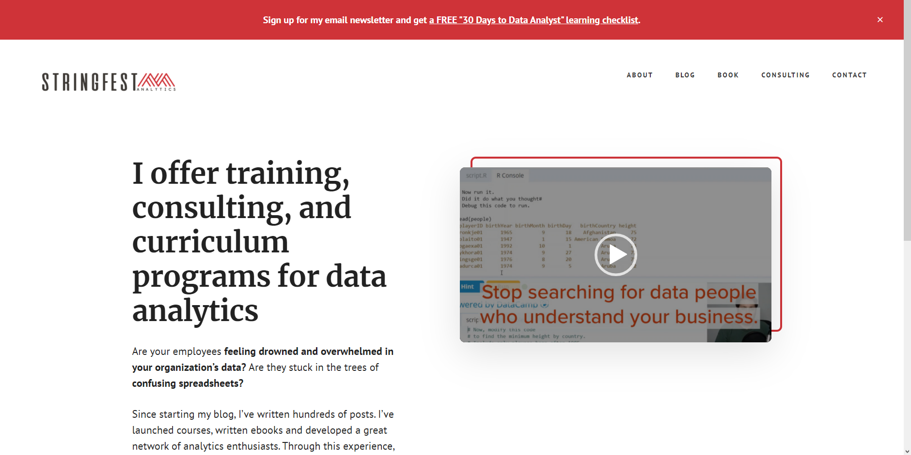
how it started
how it’s going

Slide 5

DATA ANALYSTS
R/PYTHON
R/PYTHON
R/PYTHON
ADVANCED ANALYTICS
REPRODUCIBLE PROJECTS
AUTOMATED TASKS
COMPELLING VISUALIZATIONS
HIGHER PAY

Slide 6


ANALYSTS
ACCOUNTANTS
MARKETERS
INVESTORS
TEACHERS
ENGINEERS
ECOLOGISTS
EVALUATORS
PHYSICIANS
ADMINISTRATORS

Slide 7


CLIPPY GETS HIS REVENGE

Slide 8

BI tool with limited statistical capabilities:
“Sure, we can do AI…”

Slide 9

When you search online to get help and your own post shows up

Slide 10
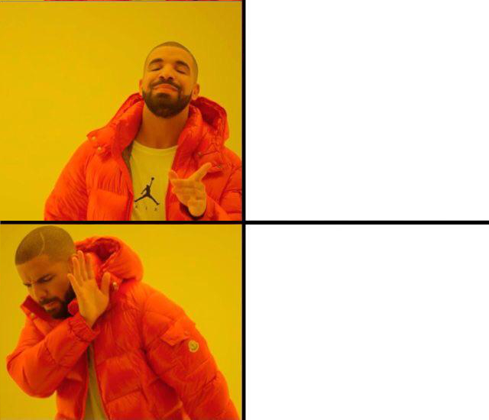
Working on a business project
Working on a business project with an upcoming deadline

Slide 11
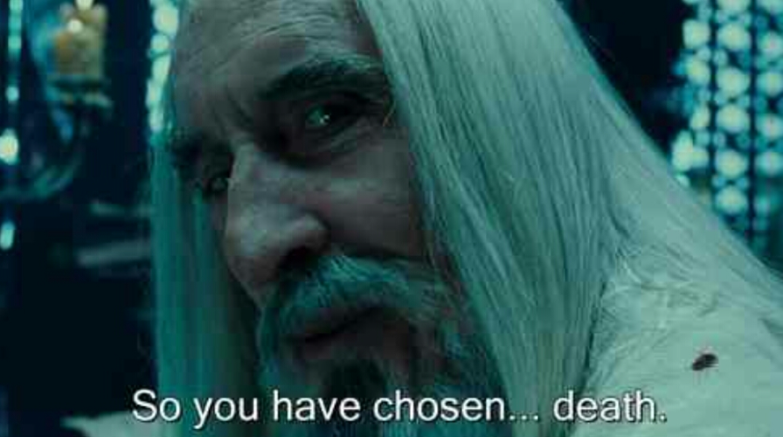
Technical debt

Slide 12

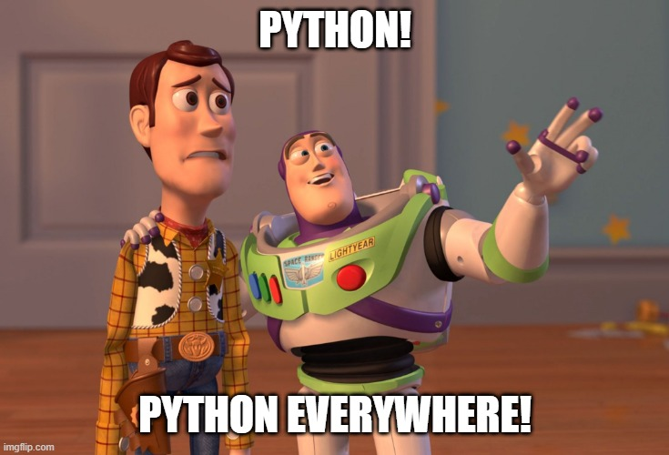




Slide 13

Salesman: *slaps roof*
“This dashboard can fit so much chartjunk in it”

Slide 14


*Slaps cover*
“This baby makes a great Christmas gift”

Slide 15
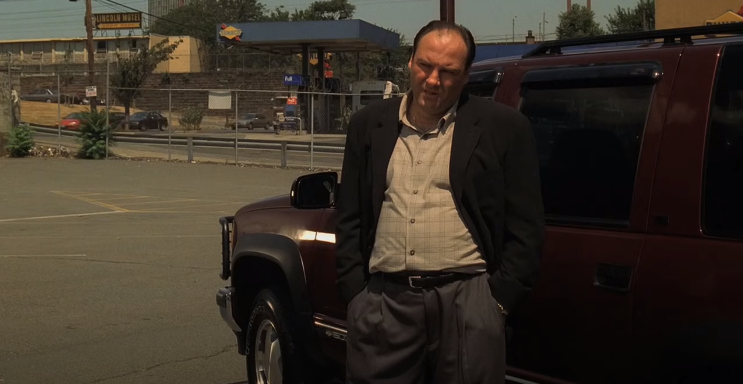
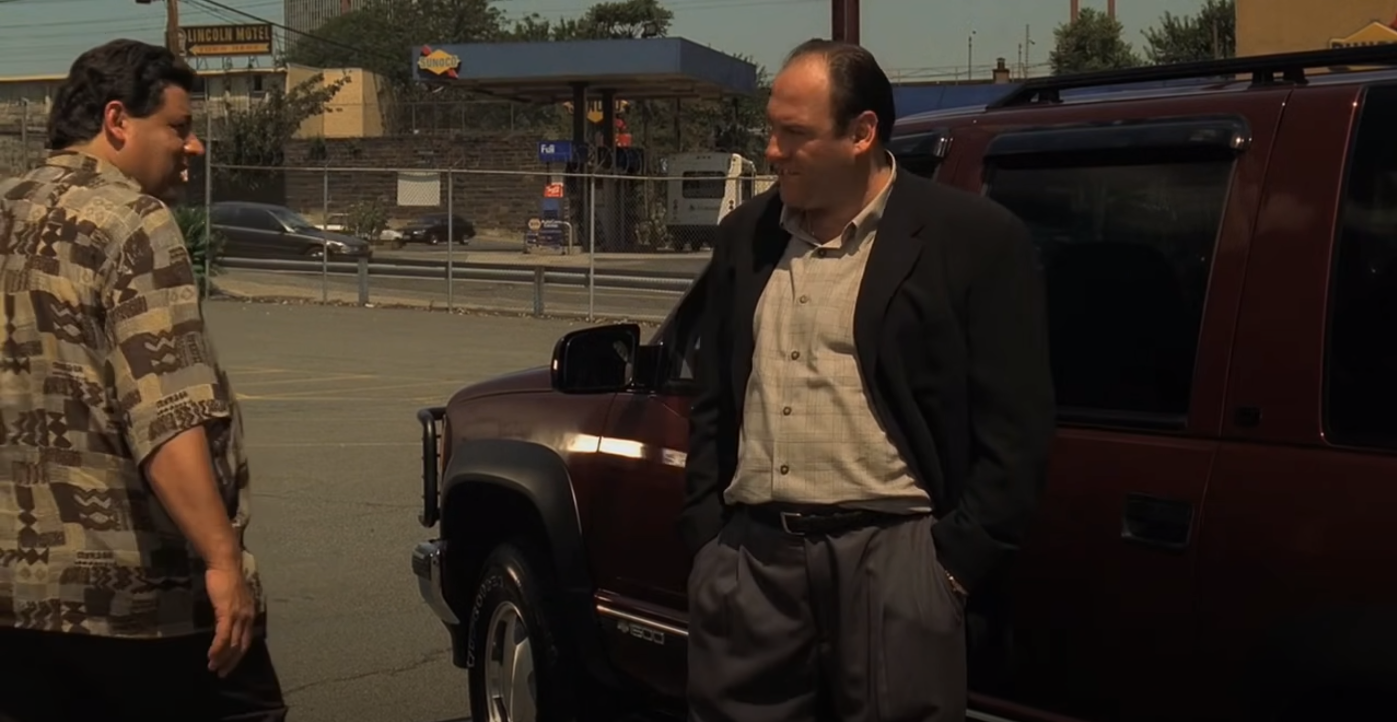
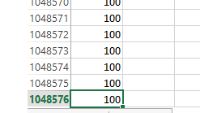

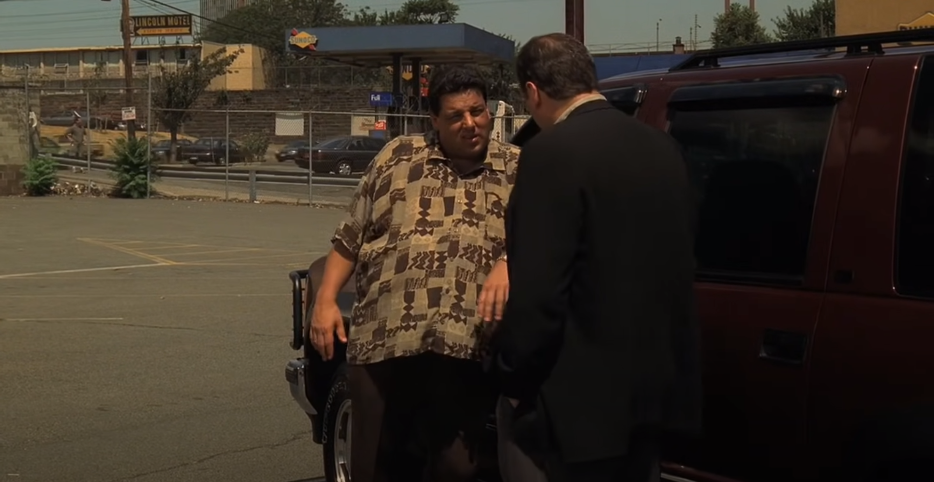
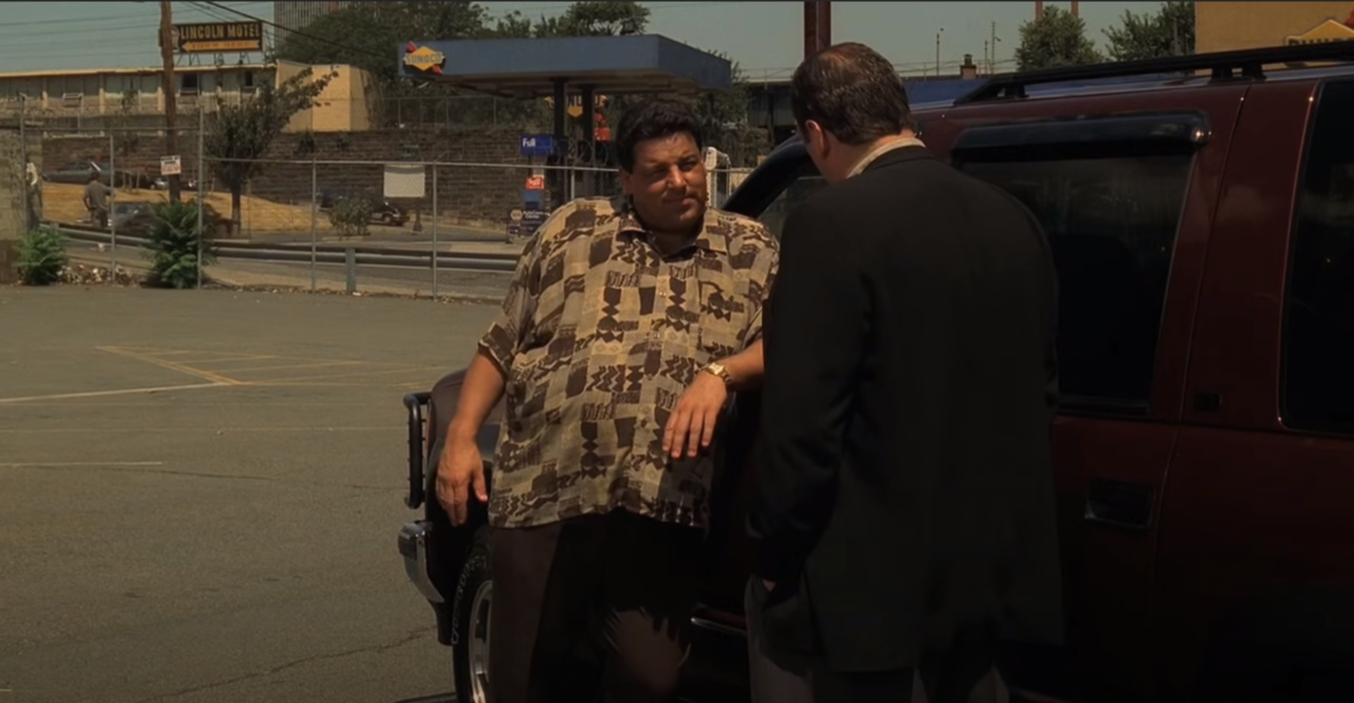
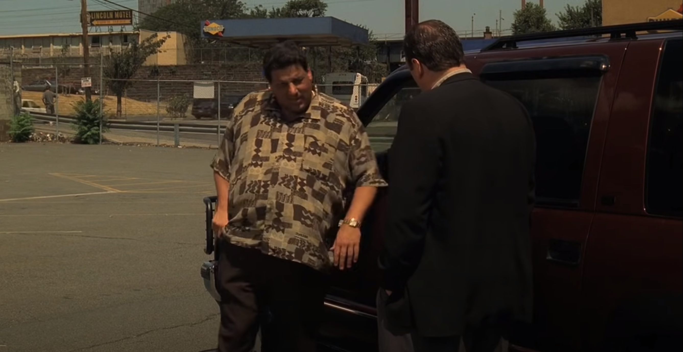
I think it's time for you to start to seriously consider Power Query.
What do you mean?
What do I mean? I mean convert that data into a table before you crash the file, you fat workbook.

Slide 16


Slide 17

“It’s not about the tools, it’s about asking the right questions”
Ought implies can. You can’t answer the questions without the tools

